Slide 1
PROJECT: Benson
By Jared Booth and Kaitlin Puryear
Booth and Puryear Data Science Inc.

Slide 2
The Problem
Our company was approached by WYWF regarding their Summer Gala.
They want to optimize the effectiveness of their street teams by using the NYC subway systems.

Slide 3
Refocus the Problem
Decoding their problem….
We are looking for places that are near:
Busy subway stations
Wealthy populations
Populations who would be interested in donating to a tech nonprofit

Slide 4
The Plan
Obtain MTA turnstile data:
Obtain busiest subway stations
Obtain US census data to obtain income values:
Clean census data and obtain boroughs/sub-boroughs that have high average incomes
Obtain location data for Startups in NYC:
Correlate location of NYC startups with busiest subway stations and wealthiest sub-borough

Slide 5
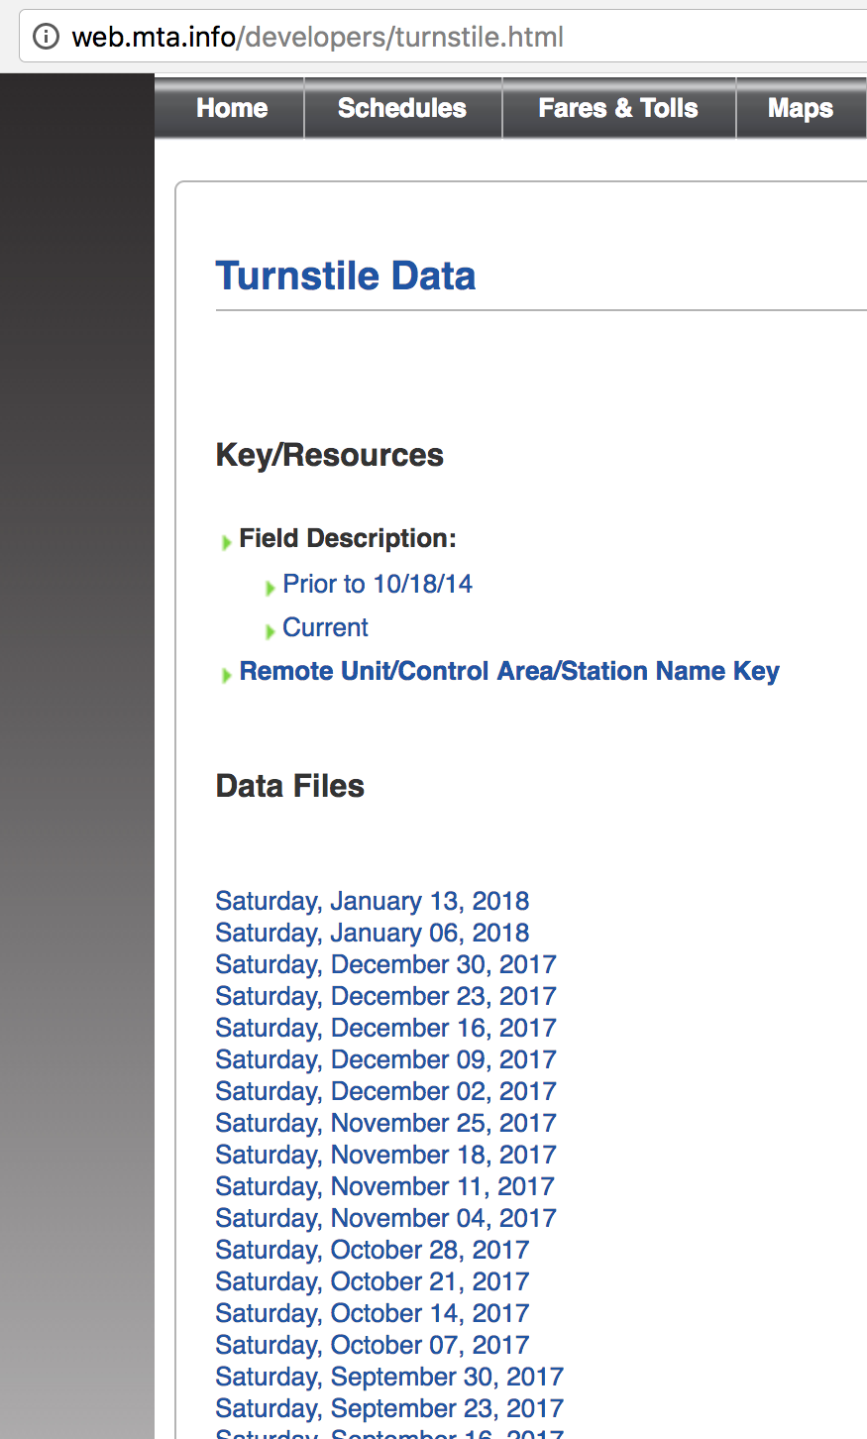
MTA Data Acquisition
Data acquired from the MTA website
Data organized by week:
We decided to use 4 weeks of data
April 15, 2017 – May 12, 2017
To preceed the Summer Gala
Plan with the data:
Create graphics to describe how busy each subway station is, per day.

Slide 6
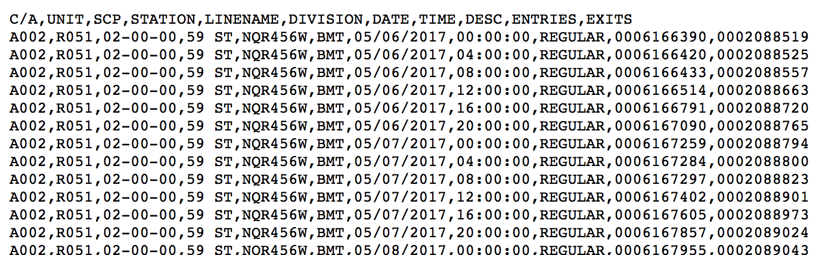
Raw MTA Data
Raw data appears like this:
The data available contains more information than we need.

Slide 7
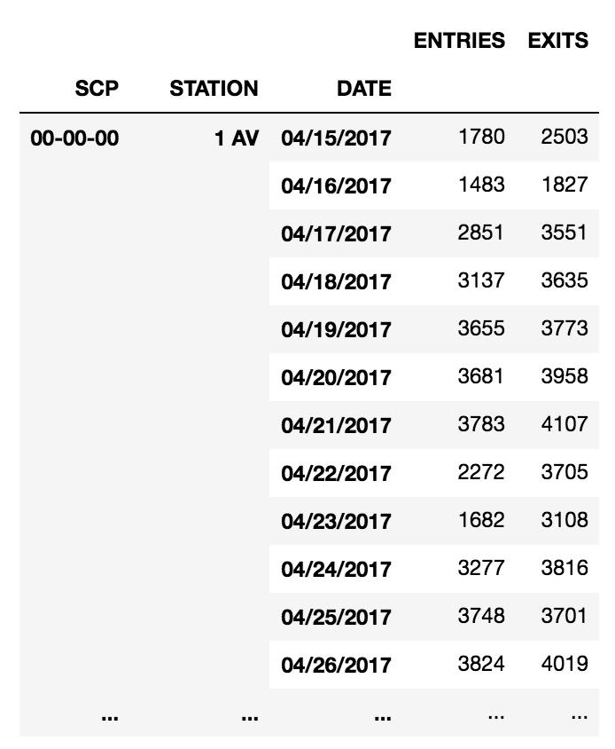
Cleaning the MTA data
The MTA data took alot of cleaning.
We care about:
Station
Date
Entries
Used Pandas to group the data into actionable dataframes

Slide 8
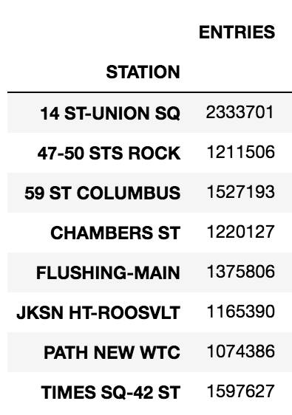
MTA Results
Located the 8 busiest subway stations
How many people used that station during the whole month
Then did deeper analysis on each station

Slide 9
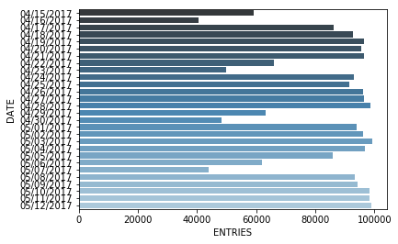
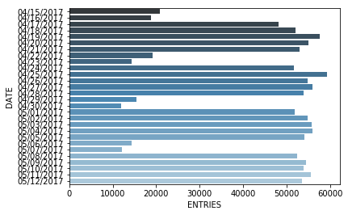
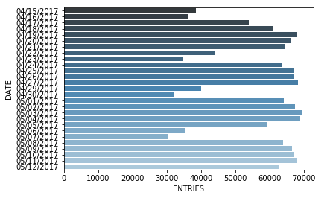
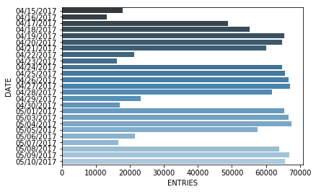
47-50 sts Rock
14th St, Union Square
Chambers St
59th St, Columbus

Slide 10
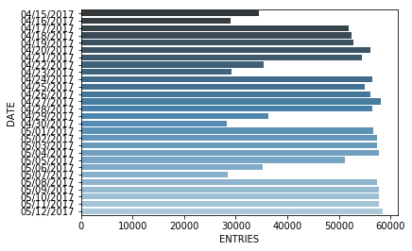
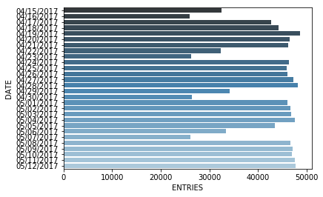
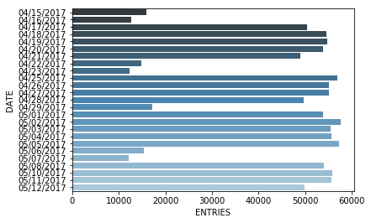
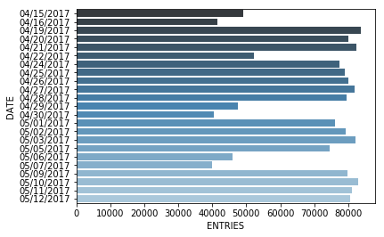
Flushing, Main
JKSN HT, Roosevelt
Path, New WTC
Times Sq, 42nd St

Slide 11
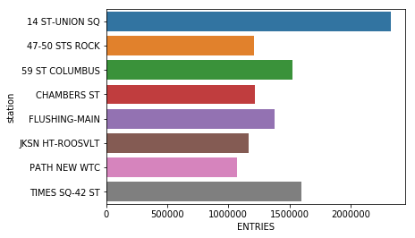
Entries During the Month
2,333,701
1,211,506
1,527,193
1,220,127
1,375,806
1,165,390
1,074,386
1,597,627

Slide 12
Subway Map
Include a picture of the subway map.
Highlight the stations we are showing graphs of

Slide 13
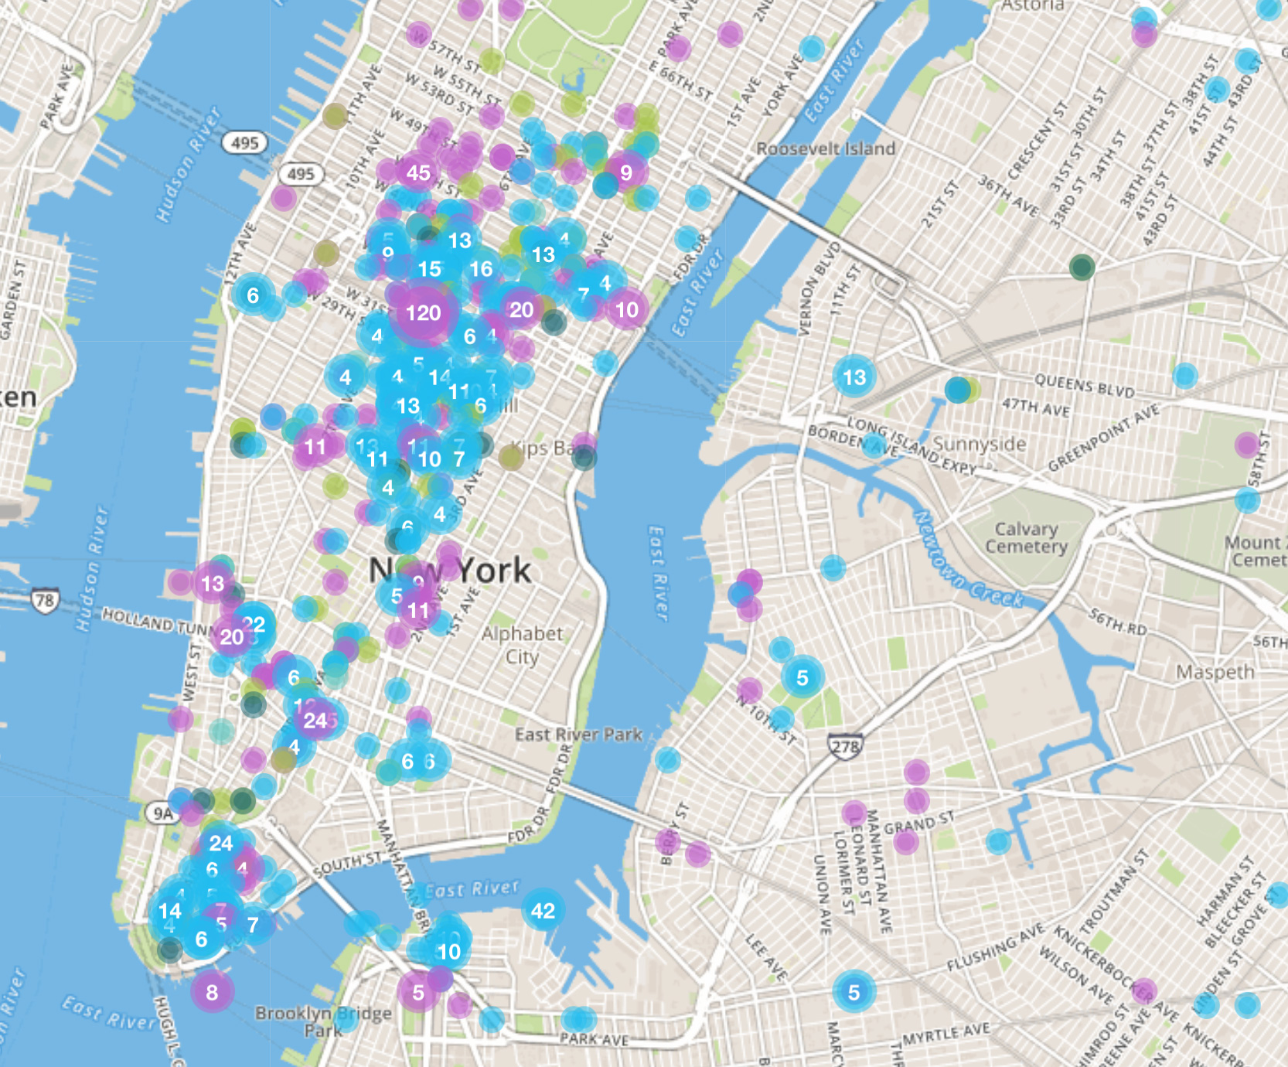
Startup locations
We found this map of startups at website..
We learned that majority of the startups in NYC are located in Manhattan.

Slide 14
Census Information
This data comes from the U.S. census.
This data is organized such that each row corresponds to a different response and contains a 172 character string of numbers.
Plan for the data:
Use the income data to find the wealthiest sub-boroughs in NYC

Slide 15
Raw Census Data
Example:
Pulled relevant data.
Borough
Sub-Borough
Total Income
Luckily this data came with a key.

Slide 16
Census Analysis Techniques
Using the key we could pull out the information we needed and create a data frame where each row index was a different response and the columns were total income, borough and sub-borough.
Once we had the data frame ready we could group the rows by borough and then by sub-borough and obtain information about the wealth in these areas.

Slide 17
Sub-Borough Income
Mean: $142,000 Median: $80,000
Mean: $48,598 Median: $32,000
Mean: $100,000 Median: $68,000

Slide 18
Sub-Borough Analysis
Graphs! Show them as large as possible.

Slide 19
Conclusions
Our MTA data shows:
The most popular stops are:
Our census data shows:
The wealthiest sub-boroughs are:
Our startup data shows:
There is a large tech interest in Manhattan

Slide 20
Correlation
Put in a graphic here that shows the combination of census data, MTA data and startups.

Slide 21
Our Recommendation
We recommend WTWY deploy a street team of X number of people to these locations() at this time():

